Slide 1
DATA STRUCTUREs
Subject Code -18B11CI311
L-T scheme: 3-1 and Credits: 4

Slide 2
Topics of the syllabus
Introduction to Data Structures
Algorithm and Complexity
Array
Searching And Sorting Algorithms
Stack
Queue
Linked List
Graph and Tree

Slide 3
Course Outcomes
18B11CI311: Data Structures
Course Outcome | Description
CO1 | Ability to define various data structures and related concepts.
CO2 | Ability to understand various data structures such as arrays, linked lists, stacks, queues, trees, and graphs, etc. along with supporting operations.
CO3 | Ability to implement algorithms based on the understanding of data structures.
CO4 | Ability to analyze the performance of algorithms based on time and space complexity measures.
CO5 | Ability to select appropriate data structures and algorithms to provide solution of the given problem.
CO6 | Ability to create new data structure /algorithm to solve new problem or project.

Slide 4
Recommended Books
Text Books:
1. Sartaj Sahni, “Fundamentals of Data Structures”, Tata Mc Graw Hill, New York
2. Seymour Lipschutz., “Data Structures with C”, Schaum's Outline Series
3. Narasimha Karumanchi, “Data Structures and Algorithms”, Careermonk Publications
Reference Books:
1. Corman et al, “Introduction to Computer Algorithms”, MIT Press
2. Langsam, Augestein, Tenenbaum,” Data Structures using C and C++”, Pearson
3. Samir K. Bandyopadhyay,” Data Structures using C”
4. Hopcraft, Ullman: “Data Structures and Algorithms”

Slide 5
Marks Distribution(Data Structures)
Component & Nature | Duration | Marks / Weightage
T1 | 1 hr | 15
T2 | 1&1/2 hrs | 25
T3 | 2hrs | 35
Tutorials |  | 05
Attendance |  | 05
Quiz |  | 05
Assignments |  | 10
Total |  | 100

Slide 6
Marks Distribution(Data Structures Lab)
Component & Nature | Duration | Marks / Weightage
P1 (Mid sem lab – Viva/Test) | 2 hrs | 15
P2 (Mid sem lab – Viva/Test) | 2 hrs | 15
Continuous Evaluation(Lab work ) |  | 40
Lab record |  | 15
Attendance & discipline in lab |  | 15
Total |  | 100

Slide 7
Prerequisite Knowledge
Students must have already registered for the course, “Software Development Fundaments” (18B11CI111).
This means that students should know basic concepts of C programming such as:
data types, operators, decision control, loops, string and functions, etc.
Dynamic memory allocation
Pointers
Structures

Slide 8
Introduction
to
Data Structures

Slide 9
Objectives of the course
To enable students to understand the basic concepts of data structures and algorithms.
To enable students to solve new problems
To enable students to write faster programs
To enable students to analyze the quality of a program
To enable students to give non-trivial solution to given a problem

Slide 10


Preface of data structure
Unorganized room
Well organized room

Slide 11
Preface of Data Structures
Data Structure = Data +Structure
Data: simply a value or a set of values of different types like string, integer, char, etc.
Structure: Ways of organizing data, so that it is easier to use when required.
Hence a data structure is a particular way of organizing data in a computer memory so that it can be used efficiently.
One of the most crucial aspects of how quickly a problem can be solved is how the data is stored in memory.

Slide 12
Need of Data Structures
Although, computers can perform millions of mathematical computations per second, when a problem gets larger and complicated, the performance can be an important consideration.
Human requirements with computers are going to extremely complex day by day.
To solve the complex problems in efficient manner we need data structures.

Slide 13
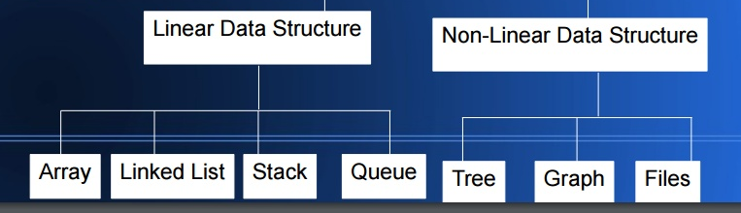
Classification of Data Structure

Slide 14
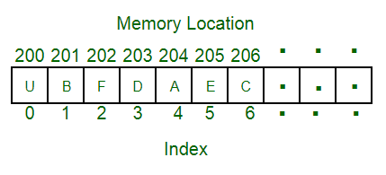
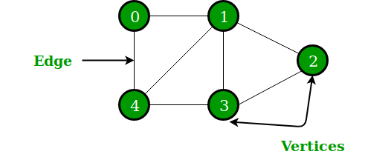
Linear Vs Non-linear Data Structures
Linear Data Structures: Elements are arranged in a sequential manner, where each element has a unique predecessor and successor (except for the first and last elements).
Ex: Arrays, Linked Lists, stacks,queue
Non-Linear Data Structures: The data items are not necessarily arranged in a sequential structure.
The relationship between elements can be more complex, forming hierarchical or interconnected structures.
Ex: Trees, Graphs

Slide 15
Operations on Data Structures
Basic operations –
Traversing – Accessing and processing record exactly once
Insertion – Adding new record to data structure
Deletion – Removing particular record from the data structure
Searching – Finding the location of the record in data structure
Special operations –
Sorting – Arranging the record in some specific order
Merging – Combining the records from different data structures to a single data structure

Slide 16
Commonly used data structures
Array
Linked list
Stack
Queue
Tree
Graph
Note: No single data structure works well for all the purposes, so need to learn several of them.

Slide 17
Abstract Data Type (ADT)
A data type is considered abstract when it is defined in terms of operations on it, and its implementation is hidden. i.e. an ADT is implementation independent.
Hence, in case of ADT we know what it does, but not necessarily how it does.
Examples of ADT:
1. Stack: operations are “Push: insert an item onto the stack", “Pop: delete an item from the stack", "ask if the stack is empty“.
stack implementation may be done using array or linked list or any other data structure.
2. Queue: operations are “Enqueue: add to the end of the queue", “Dequeue: delete from the beginning of the queue", "ask if the queue is empty“.
The implementation may be as array or linked list or heap.

Slide 18
Cost of Data Structures
Cost of data structure or algorithm can be calculated in terms of following parameters –
Time Complexity: Time required to perform a basic operation on data
Space Complexity: Memory space required to store the data items of data structure
Programming efforts to write code for basic operations.

Slide 19
Space – Time Tradeoff
The space-time tradeoff is a concept in computer science where you can achieve improvements in either space (memory) or time (execution speed) by using different algorithms or data structures.
The idea is that you can reduce the memory usage but increase the time complexity of an algorithm, or vice versa.
Example –
Selection sort
Time Complexity: O(n^2)
Additional space requirement: O(1)
Merge sort
Time Complexity: O(nlogn)
Additional space requirement: O(n)
In summary, Merge Sort has a more favorable space-time tradeoff in terms of time complexity, whereas, the space-time tradeoff in Selection Sort is in favor of space requirement.

Slide 20
Selection of data structure
Organization of data in memory affects the performance of algorithm
So, selection of data structure plays important role to make algorithm efficient
But, it depends on the nature of problem and operations to be supported.
Following steps can be followed to select an efficient data structure –
Analyze the problem very carefully and estimate requirement of the resources so that solution must meet.
Determine the basic operation to be supported
Select the best data structure which meets the above requirements.

